Slide 1
2019
Medicare Advantage
Plan Overview
Y0027_18-083_MK_M CMS Approved 08/10/2018

Slide 2
A Note About This Presentation
This presentation is specific to Medicare Advantage HMO plans that include Part D drug coverage.
CoxHealth MedicarePlus is an HMO plan with a Medicare contract. Enrollment in CoxHealth MedicarePlus depends on contract renewal. Our plan includes Part D drug coverage. To enroll, you must have both Medicare Parts A and B and reside in the CoxHealth MedicarePlus service area.
You must continue to pay your Medicare Part B premium. Enrollment in CoxHealth MedicarePlus may be limited to specific times of the year.
This information is not a complete description of benefits. Call 1-866-597-9560 (TTY: 711) for more information.

Slide 3
A Note About This Presentation
Members must use plan providers except in emergency or urgent care situations. If a member obtains routine care from an out-of-network provider without prior approval from Essence Healthcare, neither Medicare nor Essence will be responsible for the costs.
Essence Healthcare complies with applicable Federal civil rights laws and does not discriminate on the basis of race, color, national origin, age, disability or sex. ATENCIÓN: Si habla español, tiene a su disposición servicios gratuitos de asistencia lingüística. Llame al 1-866-597-9560 (TTY: 711). UWAGA: Jeżeli mówisz po polsku, możesz skorzystać z bezpłatnej pomocy językowej. Dzwoń pod numer 1-866-597-9560 (TTY: 711).

Slide 4
Your Medicare Options
4

Slide 5
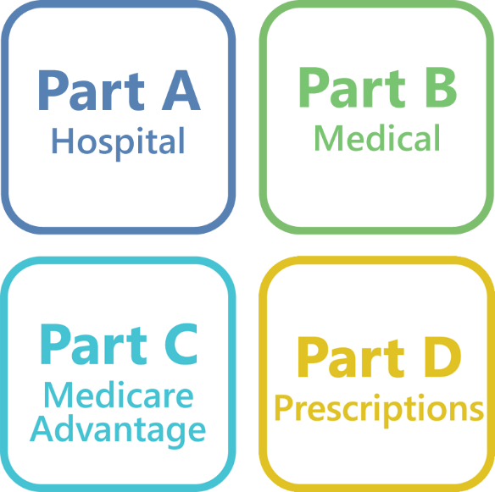
The Parts of Medicare
Five categories make up the majority of your total healthcare costs:
Hospital
Medical
Prescription Drugs
Dental
Vision
Original Medicare covers some of your healthcare costs.
Medicare consists of four different parts:
Original Medicare or traditional Medicare
Part A: Hospital Stays
Part B: Doctor Visits
Part C: Medicare Advantage
Part D: Prescription Drugs

Slide 6
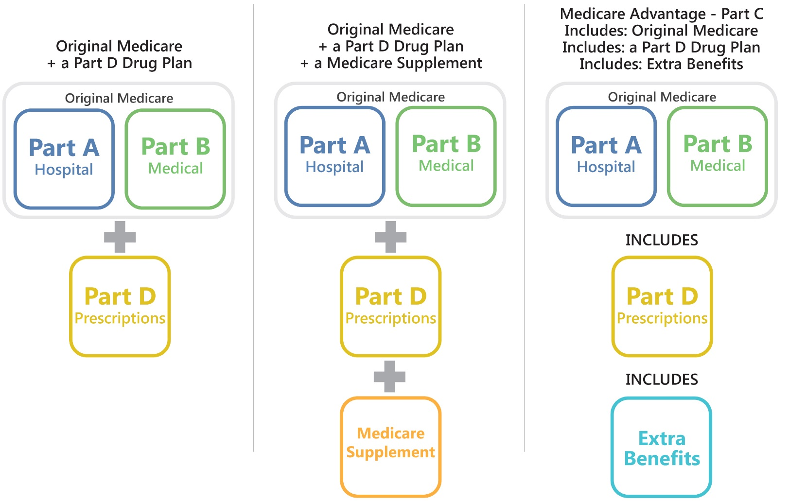
Medicare Coverage Options
Because Original Medicare only covers 80% of your medical costs and does not include prescription drug coverage, most people choose additional coverage through one of these options. In each option, you are responsible for the Part B premium.

Slide 7
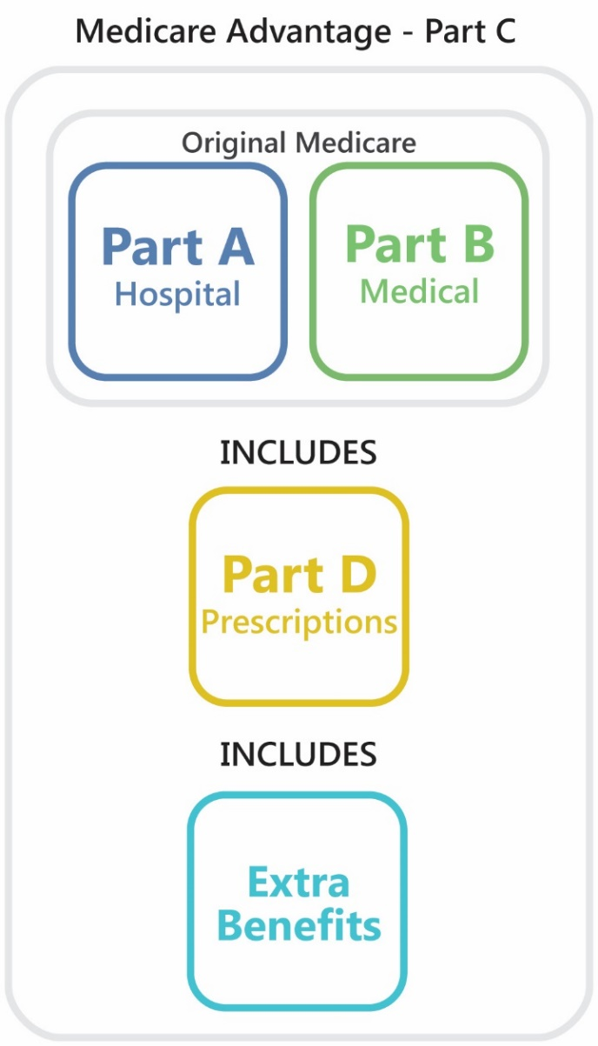
The Advantages of Medicare Advantage
A popular option among people in Missouri
Provided by private companies that are paid by the government to administer your Medicare benefits
Simpler, more affordable way to get all your coverage
Covers everything that Original Medicare covers
PLUS typically includes Part D drug coverage
AND often includes additional benefits such as dental and vision
Avoid paying expensive premiums for Medicare supplements or standalone Part D drug plans
Medicare Advantage plans are in the Medicare program
You have all the same rights and protections as Original Medicare
More personal and attentive service than you typically find with other Medicare options

Slide 8
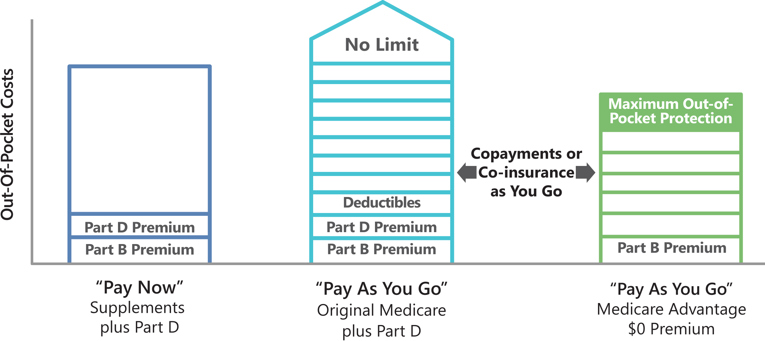
Comparing Your Out-of-Pocket Costs
Your total out-of-pocket costs differ greatly between Original Medicare, Medicare supplement plans and Medicare Advantage plans.
What you pay and when you pay is different with each option.

Slide 9
About CoxHealth MedicarePlus (HMO)

Slide 10
How CoxHealth MedicarePlus Came About
Two Missouri healthcare leaders came together to form CoxHealth MedicarePlus.
Together, these two organizations offer the advantages of Medicare Advantage to residents of Southwest Missouri.
CoxHealth
Serves 900,000 in Southwest Missouri and Northwest Arkansas
Five hospitals, 80 clinics in 25 communities
Essence Healthcare
Focused on needs of people with Medicare
Serves more than 60,000 members in Missouri
Together, these two organizations offer the advantages of Medicare Advantage to residents of southwest Missouri.

Slide 11
Why So Many People
Choose CoxHealth MedicarePlus

Slide 12
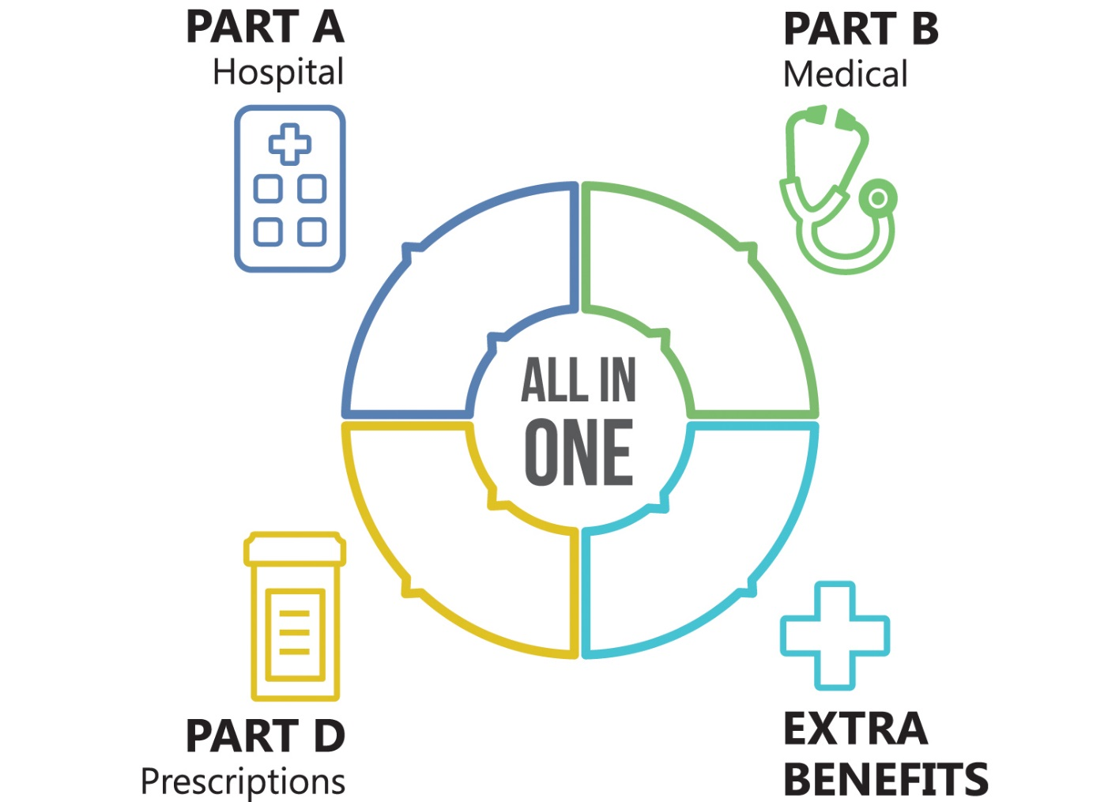
All The Benefits You Need in One Plan from One Company
CoxHealth MedicarePlus bundles all the parts of Medicare into one plan so the coverage you need is:
Easier to get
Simpler to use
More affordable
We eliminate the hassle of dealing with more than one company
You can avoid paying multiple premiums

Slide 13
Valuable Extra Benefits that Save You Money
This plan comes with valuable extra benefits with no additional premium:
Dental Coverage
Vision Coverage
Popular SilverSneakers® program
Free health club memberships
Free fitness classes
Coverage on Over-the-Counter Items

Slide 14
Lower Out-of-Pocket Costs
$0 monthly premium
$0 copays for preventive care
$0 deductibles No annoying deductibles to meet – we start covering your costs right away

Slide 15
How We Offer a Plan for $0 Premium
Medicare pays private insurance companies like Essence Healthcare to manage Medicare Advantage plans.
We save money by working with doctors and hospitals, eliminating waste and focusing on helping our members stay healthy.
We pass those savings on to our members in the form of $0 premiums, generous benefits, lower copays and no deductibles.

Slide 16
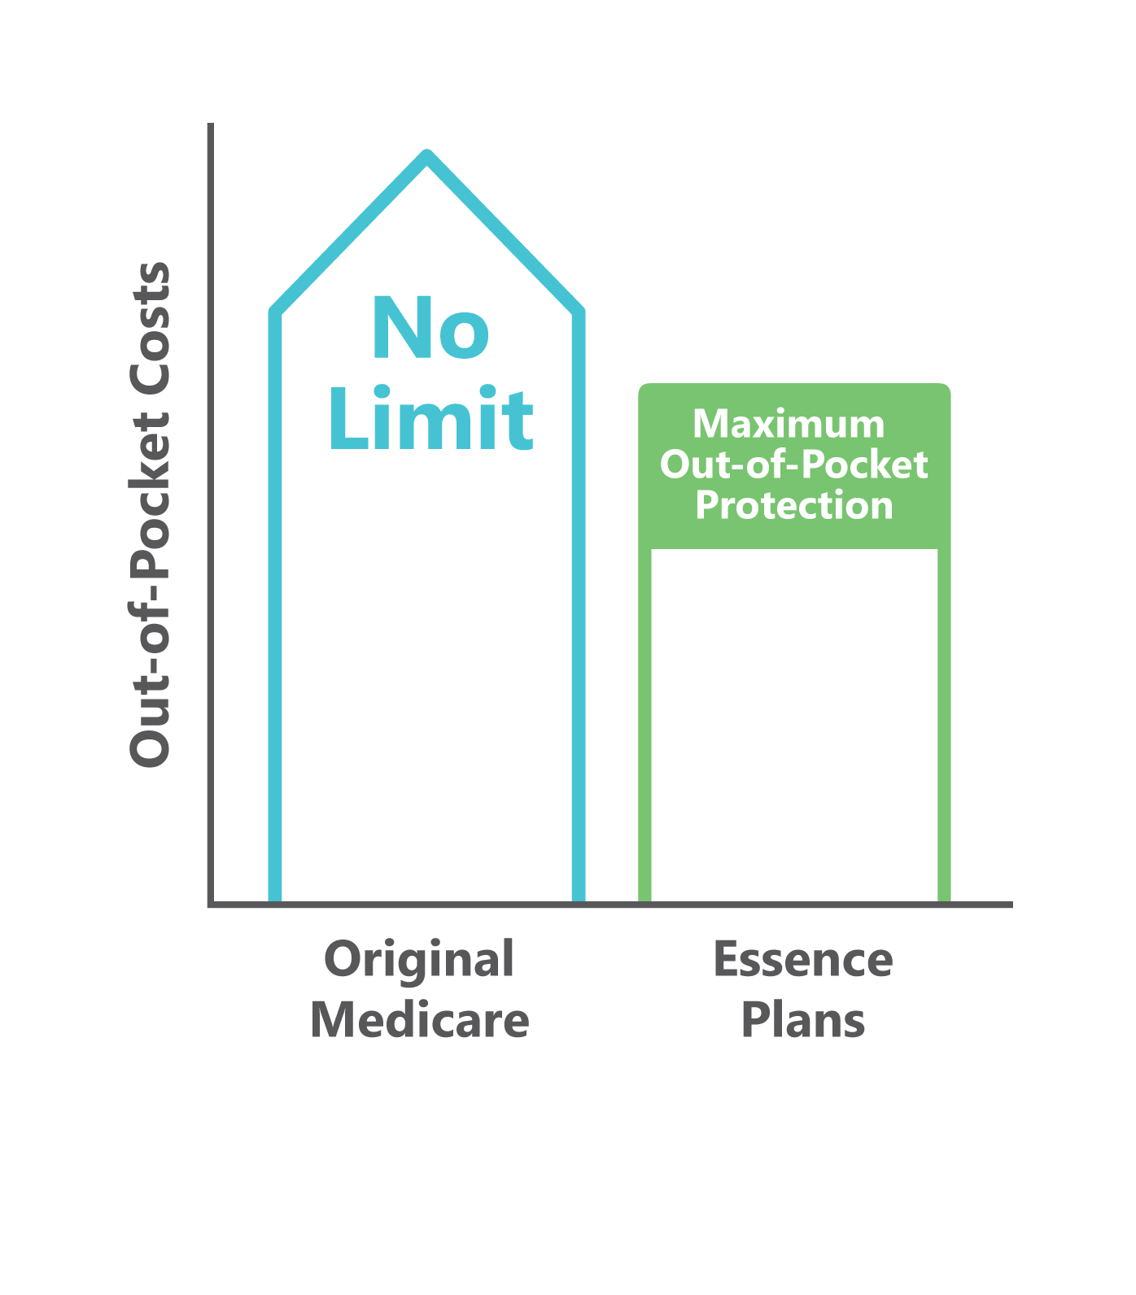
Important Financial Protection
Our plan includes maximum out-of-pocket (MOOP) protection that puts a limit on what you have to pay out of your own pocket.
No matter what happens, you will never pay more than this amount for your covered medical care each year.
It protects your savings and retirement in case of an emergency or unexpected illness.
This important protection is not offered by Original Medicare.

Slide 17
Protection When You Travel
Whether you are making a trip out of state or out of the country, we have you covered.
If you ever get sick or injured when away from home, you can rest easy knowing you have emergency or urgent care coverage.

Slide 18
Highly Rated By CMS & Our Members
Essence Healthcare, which insures CoxHealth MedicarePlus, is consistently among the highest-rated plans in the nation*.
For our latest Star Rating, please see the insert in the back of your enrollment kit. You can also visit www.medicare.gov to see how our Star Rating compares to other plans in the area.
We are also proud to have been awarded an A+ rating with the Better Business Bureau.
*Every year, Medicare evaluates plans based on a 5-star rating system.

Slide 19
Service the Way It Should Be
People join CoxHealth MedicarePlus for the great benefits, and then stay with us year after year because of our outstanding customer service.
You will never get lost trying to navigate a complicated phone tree or find yourself in endless call transfers to get an answer.
If you ever need to call us with an issue or question, a friendly and knowledgeable customer service representative in our St. Louis headquarters will promptly answer your call.

Slide 20
The CoxHealth Network of High-Quality Providers
You may choose a participating CoxHealth primary care physician to serve as your personal doctor.
Your CoxHealth doctor will take an active role in helping you manage your health and coordinating your care when you are sick or injured.
They help you navigate the complex healthcare system and make sure you get great medical care.

Slide 21
Proudly Serving Missouri Since 2004
We focus exclusively on serving people with Medicare.
We do nothing else, and because of that focus, we do it well.
We don’t answer to stockholders or Wall Street...
we answer to YOU.

Slide 22
Benefits Overview

Slide 23
Hospital & Medical Coverage
 | CoxHealth MedicarePlus (HMO)
Monthly Premium | $0
Maximum Out-of-Pocket Limit | $3,900 Per Year
Annual Deductible | $0
Preventive Care/Screenings | $0 Copay
Primary Care Physician Visits | $5 Copay
Specialist Doctor Visits | $45 Copay
Urgent Care | $45 Copay
Emergency Care | $90 Copay
Lab Services | $5 Copay
Home Health Care | 100% Coverage
Chiropractic Services | $20 Copay
Inpatient Hospital Care | $295 Per Day for Days 1-6, $0 Per Day for Day 7 and Beyond
Outpatient Surgery at Hospital | $220 Copay
Outpatient Surgery at Ambulatory Surgery Center | $220 Copay

Slide 24
Extra Benefits
 | CoxHealth MedicarePlus (HMO)
Vision Care | $35 Copay for routine eye exam $35 Copay for a pair of eyeglass frames
Preventive Dental Care | $35 Copay
Over-the-Counter (OTC) Items | $45 Per Quarter
Hearing | $20 Copay hearing exam
Travel Benefits | Emergency or urgent care coverage if you are making a trip out of state or country
SilverSneakers® | Included at no additional cost

Slide 25
Part D Drug Coverage
 | CoxHealth MedicarePlus (HMO)
Annual Deductible | $0
Tier 1 – Preferred Generics | $3 Copay for 30-day supply, $0 Copay for 90-day mail order supply
Tier 2 – Generics | $6 Copay for 30-day supply, $0 Copay for 90-day mail order supply
Tier 3 – Preferred Brands | $47 Copay for 30-day supply, $117.50 Copay for 90-day mail order supply
Tier 4 – Non-Preferred Brands | $100 Copay for 30-day supply, $250 Copay for 90-day mail order supply
Tier 5 – Specialty Drugs | 33% Co-insurance
Initial Coverage Limit | $3,820

Slide 26
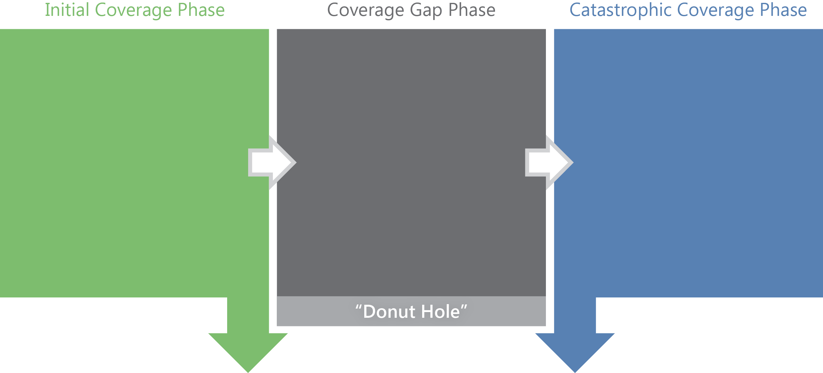
Part D Drug Coverage
You Pay:
$0 Deductible
Tier 1 - $3 Tier 2 - $6 Tier 3 - $47 Tier 4 - $100 Tier 5 - 33%
You Pay:
37% Co-insurance
(Generic Drugs)
25% Co-insurance
(Brand Name Drugs)
You Pay:
$3.40/$8.50
or
5% Co-insurance
$3,820
Initial Drug Coverage
$5,100
True Out of Pocket (TrOOP)
Notes:
In the Catastrophic Coverage Phase, after the list of copays/co-insurance, suggest adding “(whichever is more).”

Slide 27
Drug Formulary
The drug formulary lists the prescription drugs that the plan covers and the drug tier in which each drug belongs. Our formulary is available in print or online at www.coxhealthmedicareplus.com.
Exceptions and Restrictions
If a particular drug is not on our formulary, or if we have coverage limits on a drug, you can request that we make an exception by calling customer service.
Some drugs may require a prior authorization.
In some cases, we may require you to first try certain drugs to treat your medical condition before we will cover another drug for that condition (Step Therapy).
Regardless of the Medicare coverage you choose, it is important to have creditable prescription drug coverage. If you choose to wait after your initial eligibility period to enroll in Part D:
Medicare may charge you a penalty.
The penalty can be applied back to the date of your original eligibility.

Slide 28
Enrollment Information

Slide 29
Eligibility Requirements
Must have Medicare Parts A and B
Must continue to pay your Part B premium
Cannot have End-Stage Renal Disease (ESRD)
Must reside in the CoxHealth MedicarePlus service area
Greene County
Webster County
Christian County
Taney County
Stone County
Barry County
Lawrence County

Slide 30
Medicare Enrollment Periods for 2019
Annual Enrollment Period (AEP) for January 2019
October 15 – December 7
Anyone can make a change during this time
Open Enrollment Period (OEP)
January 1 – March 31
Limited to Medicare Advantage enrollees
Can make a one-time election to current plan and switch to another Medicare Advantage plan or Original Medicare
Can add or drop Part D coverage
Initial Enrollment Period (IEP)
For people turning 65 or who are otherwise first eligible for Medicare benefits
7-month window begins 3 months before your birth/eligibility month and ends 3 months after
Special Enrollment Period (SEP)
In certain special cases, as defined by CMS, people may enroll in an Essence plan outside of regular enrollment periods

Slide 31
Part B Late Enrollment
Late enrollment is allowed between January 1 and March 31
Coverage is effective July 1
A penalty applies for late enrollment in Part B
The penalty is retroactive to date of original enrollment in Medicare
You will pay this increased premium as long as you have Part B

Slide 32
How to Enroll or Disenroll
Enrolling in CoxHealth MedicarePlus
Choose a CoxHealth primary care physician (PCP) to coordinate your health care.
Complete the enrollment application*.
You will be mailed an acknowledgement letter, enrollment verification letter, new member packet and ID card.
Disenrolling from CoxHealth MedicarePlus
Enroll in another health plan
Call 1-800-MEDICARE (1-800-633-4227) 24 hours a day/7 days a week (TTY users should call 1-877-486-2048)
Notify CoxHealth MedicarePlus in writing
*Please note that plan materials are also available in non-English languages. If you require materials in another language, please call customer service.

Slide 33
Your Questions

